Slide 1




SKIN DISEASES
DETECTION
Supervised by:
Dr. Yasser Abd El Hamid
Eng. Yasmine Mahmoud
Center:
Alexandria

Slide 2

TEAM MEMBERS
Raed Mohamed Badr | 20-0﻿0898
Banoub Nagy Edwar | 20-01025
Sherif Mohamed Waheed | 20-0115﻿3
Mohamed Kamal Abdelaziz | 20-01080
Rawda Abdelhadi Alkashef | 20-0﻿0774
Rowan Abdelkader Mohamed | 20-﻿01472
Maryam Mohamed Abdelsamad | 20-00120

Slide 3

AGENDA
01
Introduction & Problem
02
Methodologies
03
Related work
04
Dataset
05
Architecture & Challenges
06
Web Application
07
Future plans & Conclusion
08
References

Slide 4


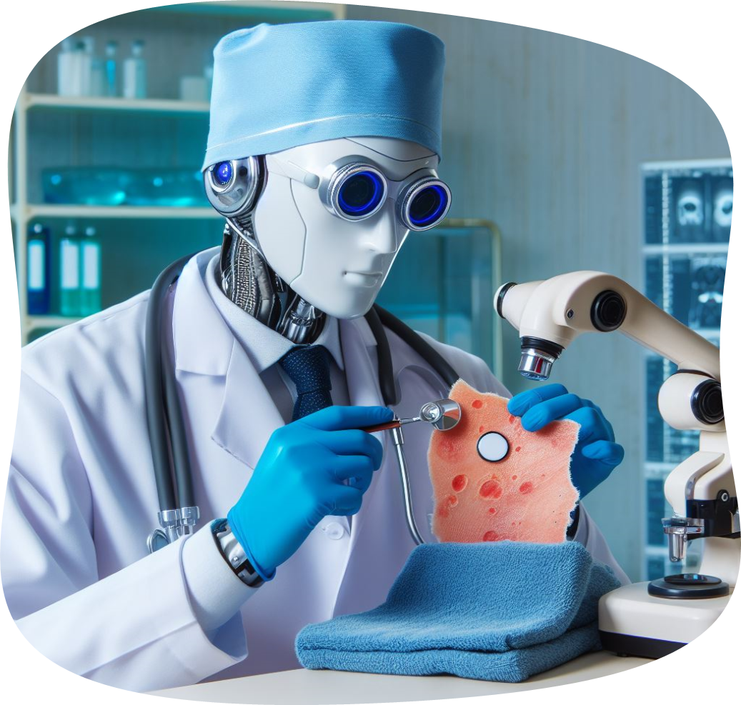
Introduction

Slide 5

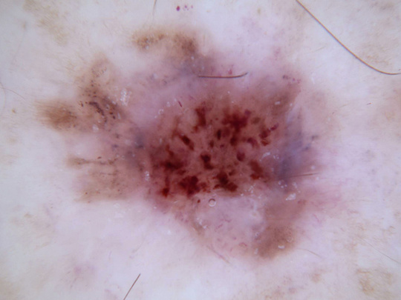
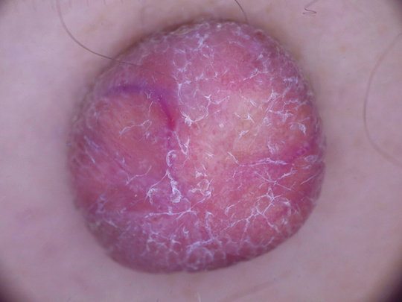

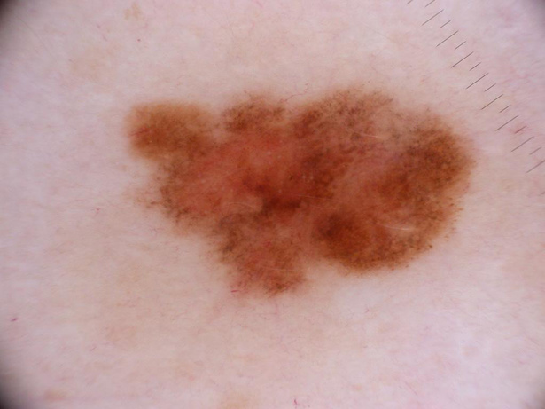
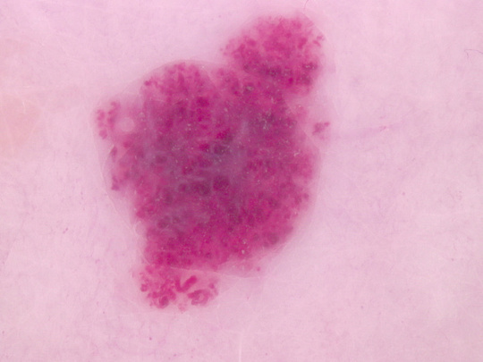
Problem
Actinic keratosis
Dermatofibroma
Melanocytic nevus
Vascular lesion

Slide 6





Objectives of Project:
Explorating Appropriate Dataset
Building DL Model
Test and Enhance The Model
Building Web App
Hosting

Slide 7
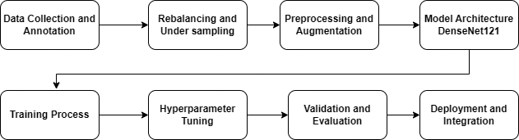

How

Slide 8

Methodology

Slide 9
•We applied insights to address project-specific challenges and optimize our decision-making processes.
•A systematic survey was conducted, analyzing datasets in a structured order, highlighting strengths and weaknesses.
•Making exploration on the algorithms that helped us in emphasizing a methodical evaluation criteria.
•Arranging the results based on priorities in terms of highest accuracy to facilitate decision-making

Slide 10

Related
Work

Slide 11

References of Skin Diseases with Deep Learning :
Paper | Year | Dataset | Accuracy
Classification of Skin Cancer with Deep Transfer Learning Method | 2022 | International Skin Imaging Collaboration (ISIC) | 97.89%
Multi-Features Extraction Based on Deep Learning for Skin Lesion Classification | 2022 | ISIC 2019 | (92.34% and 91.71% )
Early Detection of Skin Cancer Using Deep Learning Architectures | 2019 | ISIC-archive | 88.20%

Slide 12
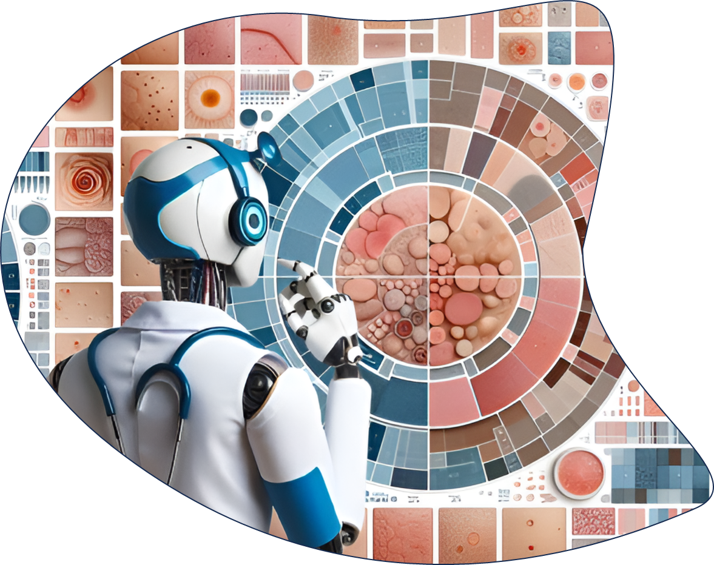
Datasets

Slide 13
Disease Name | ISIC 2019 | HAM10000 | PAD-UFES-20 | ISIC 2017 | Merge
Melanoma | 4522 | 1113 | 52 | 521 | 6208
Melanocytic | 12896 | 6705 | 244 | 0 | 19845
Basal cell | 3323 | 514 | 845 | 0 | 4682
Actinic keratosis | 867 | 327 | 730 | 0 | 1924
Benign keratosis | 2624 | 1099 | 0 | 0 | 3723
Dermatofibroma | 239 | 115 | 0 | 0 | 354
Vascular lesion | 253 | 142 | 0 | 0 | 395
Squamos cell | 629 | 0 | 192 | 0 | 821
Seborrheic keratosis | 0 | 0 | 235 | 374 | 609
Benign nevi | 0 | 0 | 0 | 1855 | 1855
Total | 23127 | 11711 | 5578 |  | 40416
 |  | 17289 | 17289

Slide 14
Priority Criteria
ISIC 2019
1
2
3
4
25k
1
Availability
HAM 10000
2
Aim to facilitate training neuron network
1
2
3
4
10k
PAD-UFES-20
Suitable number of skin diseases.
3
1
2
3
2.2k
ISIC 2017
Large number of images in each disease.
4
1
2
2.7k

Slide 15
Unused Datasets
DermNet
BCN20000
1. Num_images is very small
2. Aim to archive to medical.
3. lack of Organization.
1. Unavailable independently.
2. Embedded with ISIC 2019.
PH2
Derm7pt
1. Num_images is very small.
2. Diseases are very general.
1. Num_images is very small.
2. Diseases don’t intersect with the majority of available diseases.
Dermofit
Unavailable

Slide 16

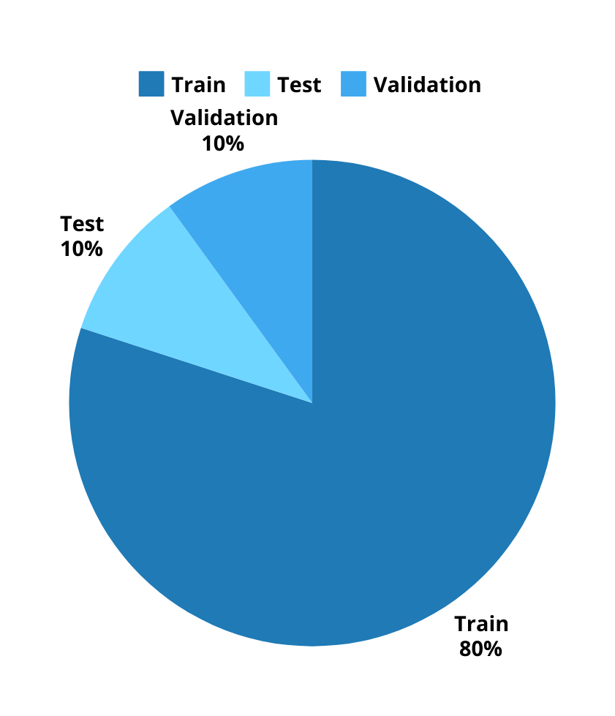

DataSet from :
Isic 2019

Slide 17

Preprocessing

Slide 18
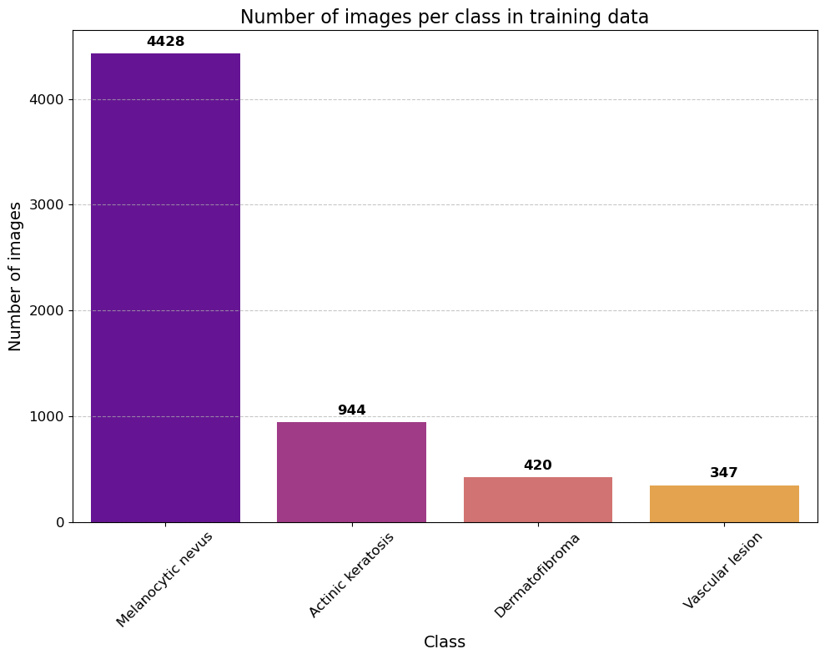
Under sampling :
An exaggerated increase for Melanocytic
There are few remaining diseases
Reduce Melanocytic From 11k to 4k

Slide 19
Data Augmentation
rescale | 1.0/255
rotation range | 40
width shift range | 0.2
height shift range | 0.2
shear range | 0.2
zoom range | 0.2
fill mode | nearest
horizontal flip | true
feature wise std normalization | true

Slide 20
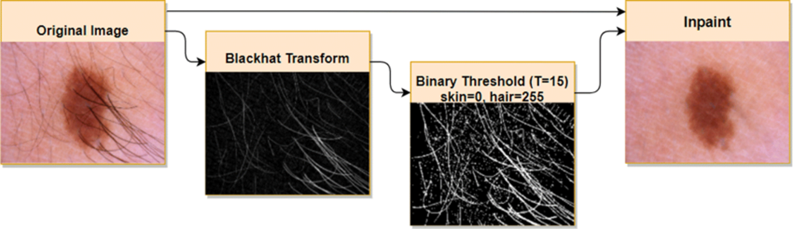
Dull razor Algorithm
Grayscale Conversion
Gaussian Filtering
Hair Mask Creation
Morphological Operations
Inpainting (Interpolation)
Result Integration

Slide 21

Proposed Final Model

Slide 22
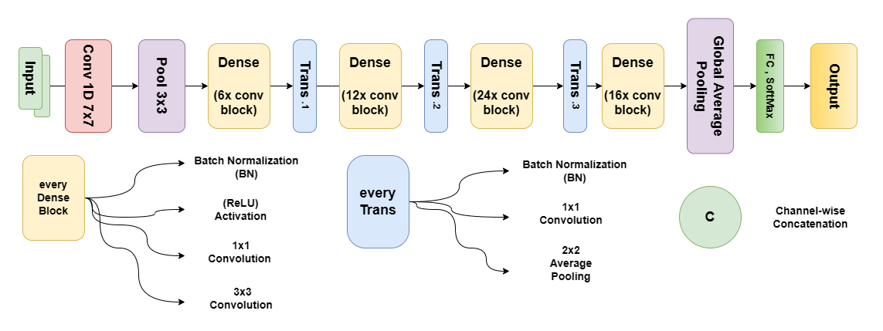
Architecture of DenseNet121
The Base Model with pre-trained Dataset ImageNet

Slide 23
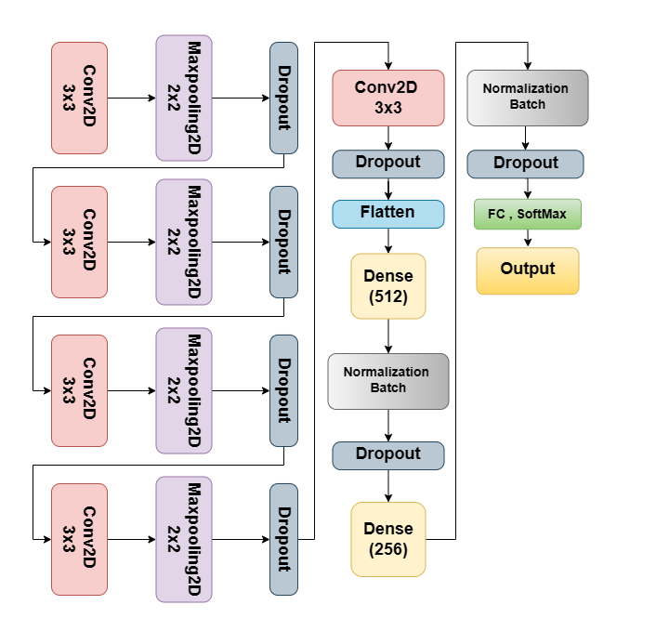
Custom Layers:
Conv2D and Dense use activation Funcation Relu
MaxPooling2D and Conv2D padding is same
Dropout (0.5/0.3)

Slide 24
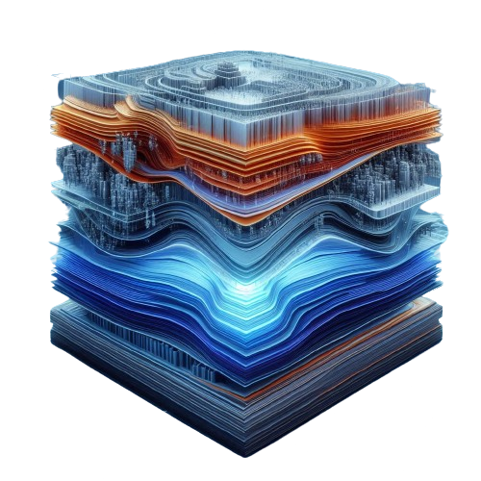

Freezing Layers:
the combination of freezing and selectively unfreezing layers is a key technique in transfer learning.
Preserve Learned Features
Adapt to New Task
Efficient Training
Unfreeze the top 30 layers

Slide 25
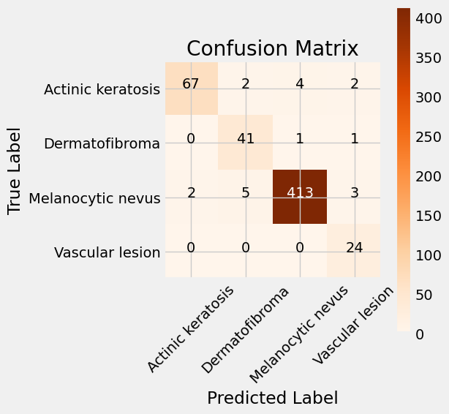
Confusion Matrix:

Slide 26
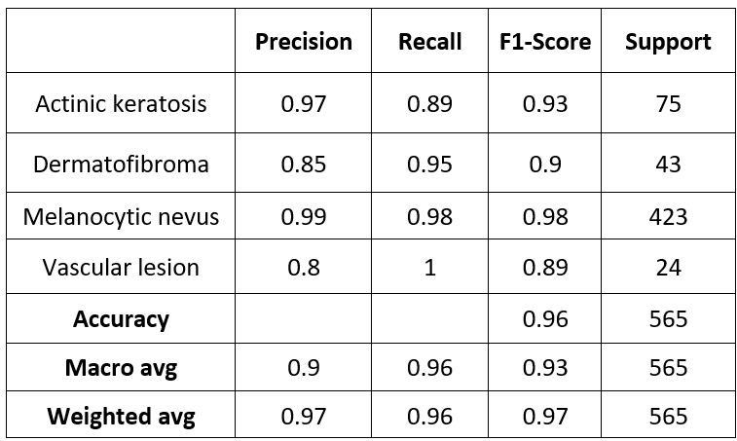
Classification Report:

Slide 27
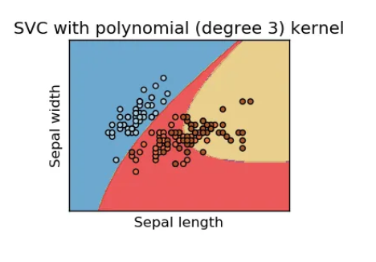
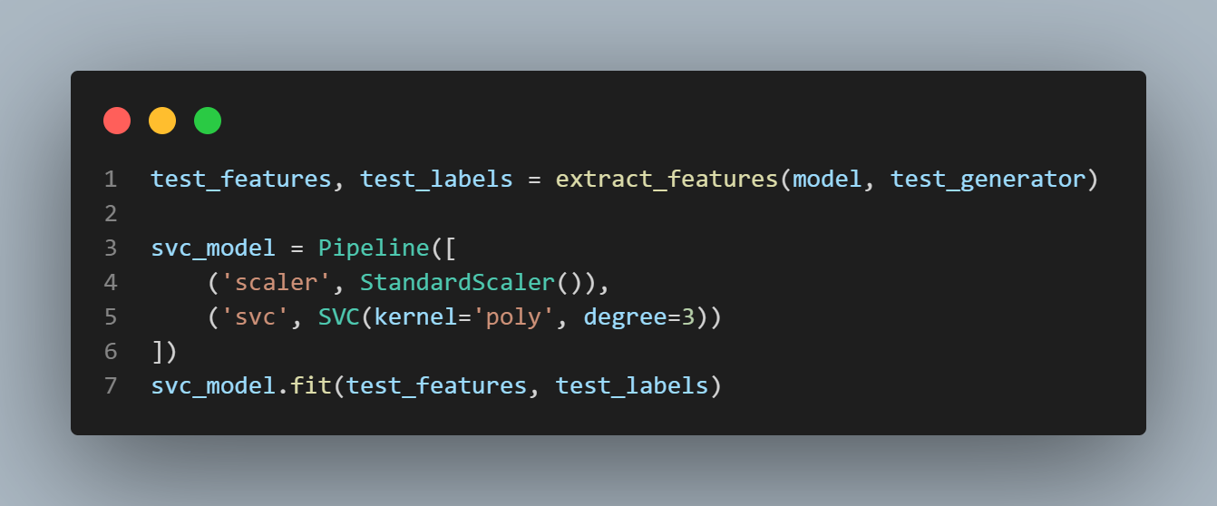
Svc Method :

Slide 28
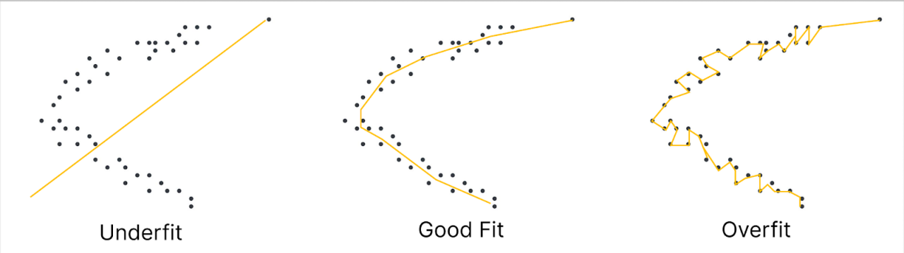
What is Overfitting?
Overfitting is a modeling error in machine learning and statistics where a model is too complex and fails to generalize to new data.
It occurs when a model is too tailored to the training data, memorizing it instead of learning true patterns, resulting in poor performance on test data or real-world applications.

Slide 29
Batch Normalization
How to Solve Overfitting ?
Dropout
Early Stopping
Tunning Hyperparameter

Slide 30
Hyperparameter:
loss function | categorical_crossentropy
activation function | Relu
dropout rates | 0.5 | 0.3
epochs | 100
batch size | 100
image size | 224 x 224
learning rate | 0.001

Slide 31
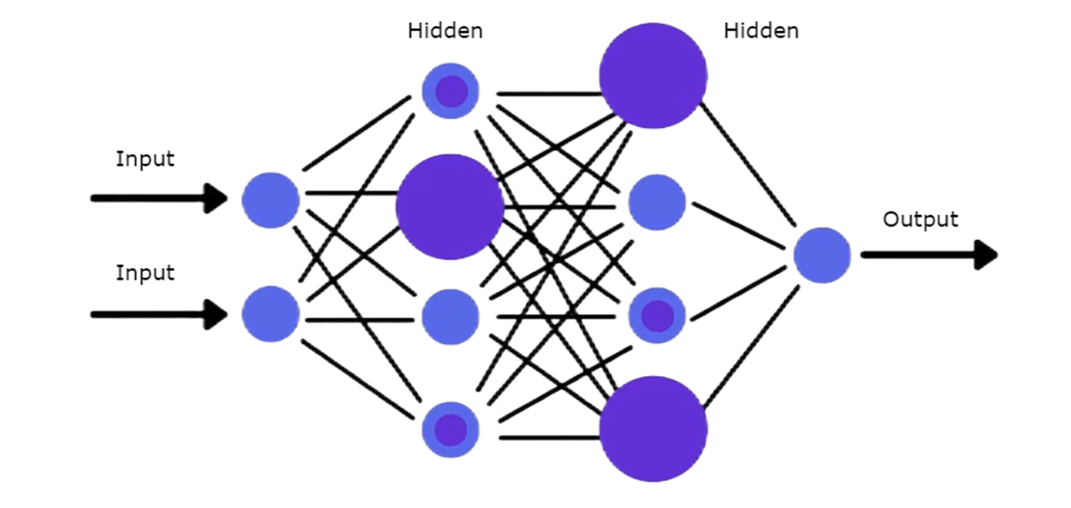
Batch Normalization
Batch normalization is a deep neural network training technique that reduces internal covariate shift by normalizing inputs to a mean of zero and variance of one.

Slide 32
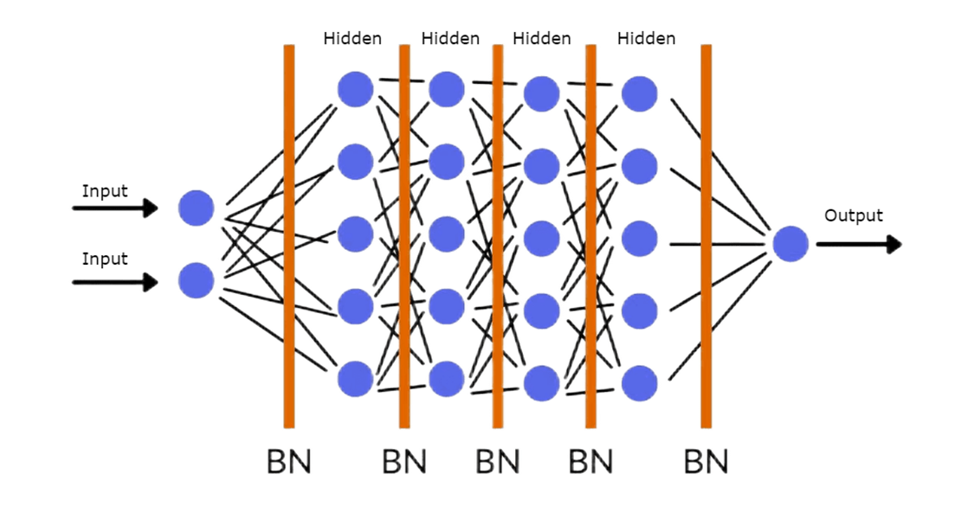
During Batch Normalization

Slide 33
Dropout
Randomly Disable Neurons:
By randomly ignoring neurons during training
During training, the remaining neurons are scaled up to maintain expected output values, such as multiplying the output of the remaining neurons by 2 if half are dropped out.

Slide 34
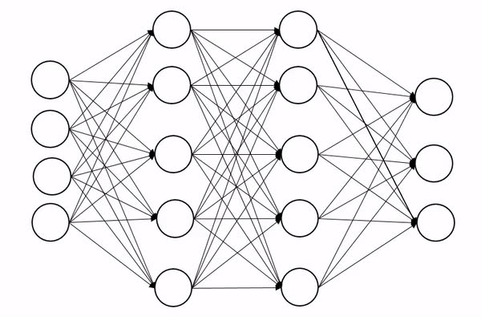
Dropout

Slide 35
Early Stopping
Method to avoid overfitting.
Early stopping involves terminating training shortly once the validation error is at its lowest level.
Many variables are used in early stops :
monitor= 'loss'
mode= 'min'
patience= 10
min_delta= 0.001

Slide 36
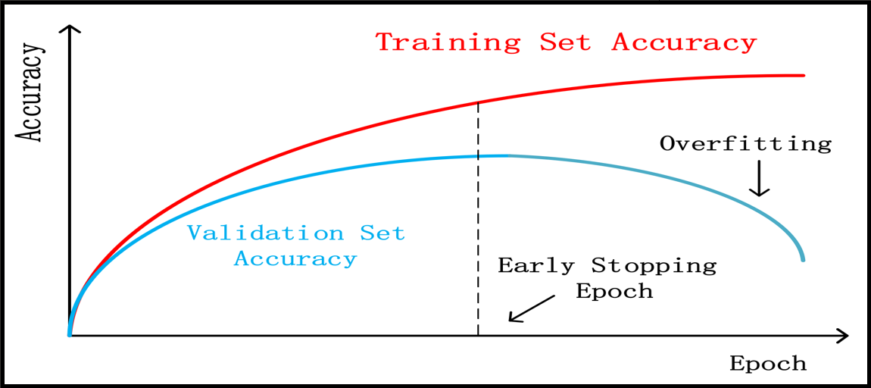
Early Stopping

Slide 37

Experiments

Slide 38
Results of Exprements:
2 April
epochs | 10
Input size | 224,224
Reduce lr | no
Dropout | 0.3 | 0.5
Unfreeze Layers | 30 top layer from base
early_stop | no
Test acc | 0.860
Test Loss | 0.717

Slide 39
Results of Exprements:
3 May
epochs | 15
Input size | 250,250
Reduce lr | yes (factor=0.1,patience = 15)
Dropout | 0.5 | 0.5
Unfreeze Layers | top 30 layer
early_stop | no
Test acc | 0.914
Test Loss | 0.422

Slide 40
Results of Exprements:
15 April after using SVC method
epochs | 100
Input size | 224,224
Reduce lr | no
Dropout | 0.5 | 0.3
Unfreeze Layers | 30 from top
early_stop | (monitor='loss', mode='min',patience=10)
Test acc | 0.959
Test Loss | 0.137
Cubic SVM Test acc | 0.9
Cubic SVM Test Loss | 0.09999

Slide 41
Results of Exprements:
30 April after reduce Melanocytic to 4k
epochs | 100
Input size | 224,224
Reduce lr | no
Dropout | 0.5 | 0.3
Unfreeze Layers | 30 from top
early_stop | (monitor='loss', mode='min',patience=10)
Test acc | 0.964
Test Loss | 0.127
Cubic SVM Test acc | 0.99
Cubic SVM Test Loss | 0.010000

Slide 42

Web Application

Slide 43
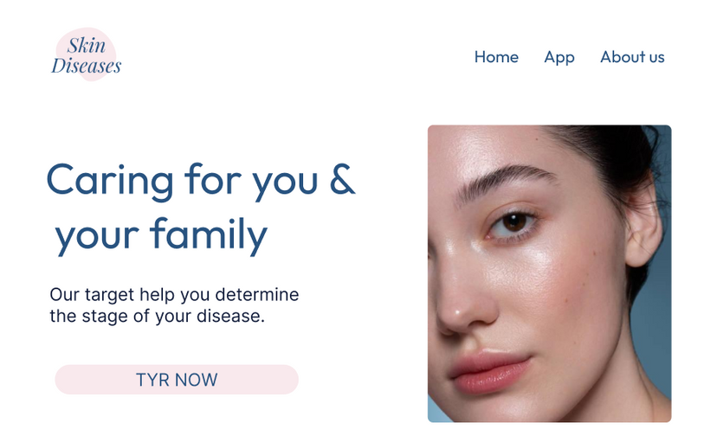


UI/UX
Full design in Figma

Slide 44




Application Stack
Front-end
Back-end
Webserver
Cloud Platform
React
Flask
Nginx
Digital Ocean

Slide 45
Data flow
API Requests
Fetch data from backend API
Handle responses and errors
State Managment
Update components based on state changes
Libraries
axois
react-dropzone
react-slideshow
Tools
eslint for code linting
Vite for module managmenet

Slide 46
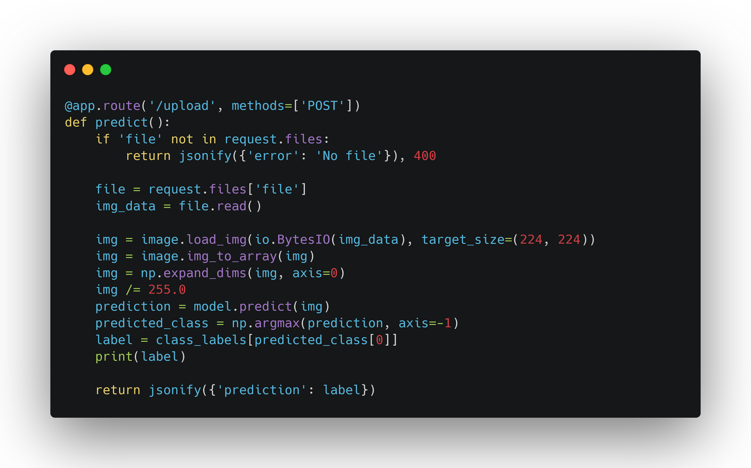

API Endpoint
AI implementation
Server response

Slide 47
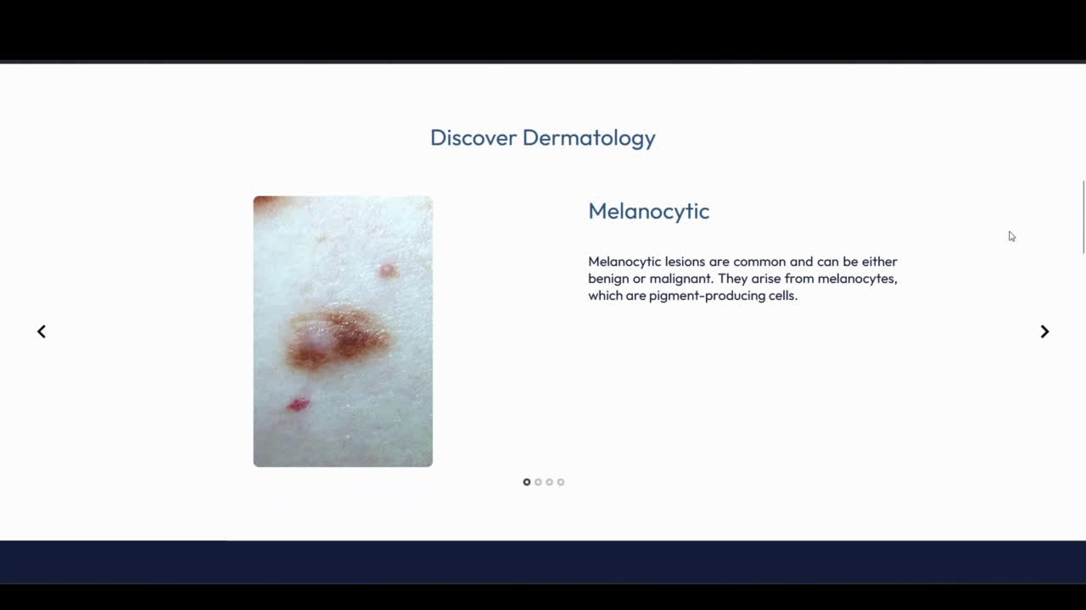
Demo

Slide 48


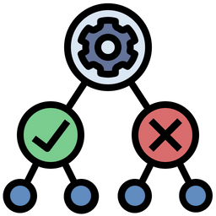
Computational time
Training model
Testing model
Testing Web App
4 hour,
26 minutes,
and 40 seconds
32 second
About 5 seconds

Slide 49

Future plans & Conclusion

Slide 50
Conclusion
The DenseNet-121 algorithm was chosen due to its proven ability to capture intricate features and efficiently manage complex image data.
The integration of a Cubic SVM classifier further enhanced the accuracy, achieving a test accuracy of 0.99 in the best experimental setup.
Effectively resolved the project's several challenges.
Create a successful Web application that will allow us to sell it with additional work and marketing.

Slide 51




Future Plans
What we hope to achieve :
Increasing the number of dermatologists on the web Application and expanding the service regions .
Expanding service
Add User Profile
Keep track of their personal data, medical history, and previous diagnoses .
Categorize Users Groups
Creating 2 categories of users by dividing membership into patients and doctors

Slide 52

Future Plans
What we hope to achieve :
We aim to publish a comprehensive research paper on our skin disease classification accuracy rate of 0.99, presenting new results in dermatological diagnostics.
contribution

Slide 53

References

Slide 54

[1] Skin Cancer MNIST: HAM10000, Kaggle, (2018, September 20). https://www.kaggle.com/datasets/kmader/skin-cancer-mnist-ham10000
[2] International Skin Imaging Collaboration. (n.d.), ISIC, https://www.isic-archive.com/
[3] Pacheco, A. G. C., Lima, G. R., Salomão, A. S., Krohling, B. A., Biral, I. P., De Angelo, G. G., Alves, F. C. R., Esgario, J. G. M., Simora, A. C., Castro, P. B. C., Rodrigues, F. B., Frasson, P., Krohling, R. A., Knidel, H., Santos, M. C. S., Santo, R. B. D. E., Macedo, T. L. S. G., Canuto, T. R. P., & De Barros, L. F. S. PAD-UFES-20: A skin lesion dataset composed of patient data and clinical images collected from smartphones. Data in Brief, 32, 106221,(2020), https://doi.org/10.1016/j.dib.2020.106221
[4] Combalia, M. BCN20000: Dermoscopic lesions in the wild, arXiv.org, (2019, August 6), https://arxiv.org/abs/1908.02288

Slide 55
[5] Dr Ian Coulson. DermNet. (2021). https://dermnetnz.org/
[6] Mendonca, T., Ferreira, P. M., Marques, J. S., Marcal, A. R. S., & Rozeira, J. PH2 - A dermoscopic image database for research and benchmarking. 2013 35th Annual International Conference of the IEEE Engineering in Medicine and Biology Society (EMBC), (2013), https://doi.org/10.1109/embc.2013.6610779
[7] ADDI - Automatic computer-based Diagnosis system for Dermoscopy Images, (2013), https://www.fc.up.pt/addi/ph2%20database.html
[8] Rees, Aldridge, Fisher, Ballerini, A Color and Texture Based Hierarchical K-NN Approach to the Classification of Non-melanoma Skin Lesions, Color Medical Image Analysis, Lecture Notes in Computational Vision and Biomechanics 6 (M. E. Celebi, G. Schaefer (eds.)), (2013) https://licensing.edinburgh-innovations.ed.ac.uk/product/dermofitimage-library
[9] Mendes, D. B. Skin lesions classification using convolutional neural networks in clinical images. arXiv.org, (2018, December 6), https://arxiv.org/abs/1812.02316

Slide 56
[10] Demir, A., Yilmaz, F., & Kose, O. Early detection of skin cancer using deep learning architectures: resnet-101 and inception-v3, TIPTEKNO 2019, https://doi.org/10.1109/tiptekno47231.2019.8972045
[11] Al-Saedi̇, D. K. A., & Savaş, S. Classification of Skin Cancer with Deep Transfer Learning Method, Computer Science, (2022), https://doi.org/10.53070/bbd.1172782
[12] Rehman, M. Z. U., Ahmed, F., Alsuhibany, S. A., Jamal, S. S., Ali, M. Z., & Ahmad, J. Classification of skin cancer lesions using explainable deep learning, Sensors, 22(18), 6915, (2022),
https://doi.org/10.3390/s22186915
[13] Chaturvedi, S. S., Gupta, K., & Prasad, P. S. Skin lesion analyser: An efficient Seven-Way multi-class skin cancer classification using MobileNet, In Advances in intelligent systems and computing (pp. 165–176),(2020), https://doi.org/10.1007/978-981-15-3383-9_15

Slide 57
[14] Srinivasu, P. N., SivaSai, J. G., Ijaz, M. F., Bhoi, A. K., Kim, W., & Kang, J. J. Classification of Skin Disease Using Deep Learning Neural Networks with MobileNet V2 and LSTM, Sensors, 21(8), 2852, (2021), https://doi.org/10.3390/s21082852.
[15] Kaya, V., & Akgül, İ. Classification of skin cancer using VGGNet model structures. Gümüşhane Üniversitesi Fen Bilimleri Enstitüsü Dergisi, (2022), https://doi.org/10.17714/gumusfenbil.1069894
[16] Pai, V. R., Pai, S. G., Suhasi, P. M., & Rekha, P. M. Identification and Classification of Skin Diseases using Deep Learning Techniques, Research Square (Research Square), (2023), https://doi.org/10.21203/rs.3.rs-2628782/v1.
https://arxiv.org/pdf/1512.03385.pdf

Slide 58


THANK'S FOR WATCHING

